Slide 1

An Introduction To Compassion Focused Therapy and Compassion Focused ACT
For Anxiety and Depression
Dennis Tirch PhD
&
Laura Silberstein Tirch PsyD
The Center for Compassion Focused Therapy,
New York, NY
http://www.mindfulcompassion.com
With presentation materials from
P. Gilbert PhD & the greater
Compassionate Mind Foundation community

Slide 2
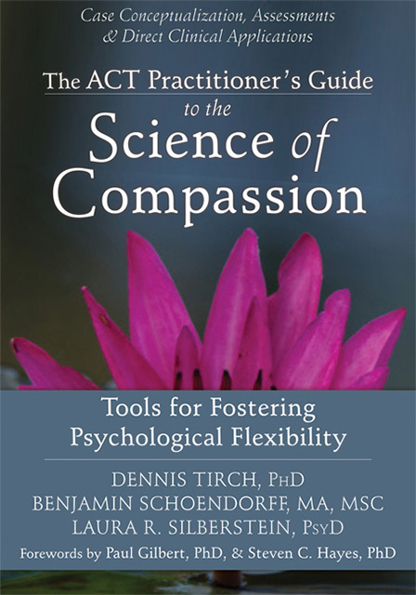
The ACT of Compassion

Slide 3

Attention and Heroism

Slide 4

“A Beginning is Invisible” - Robert Fripp

Slide 5
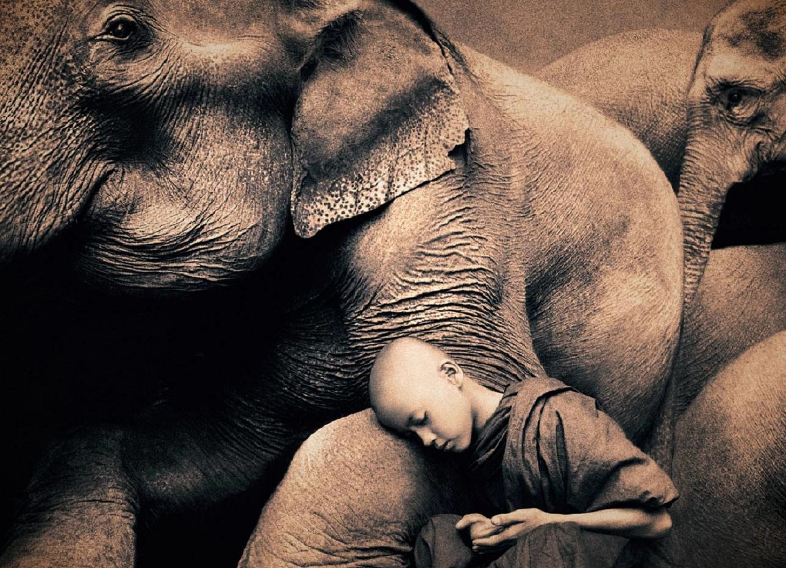

Relevant Histories For Our Work
You & I
Mary
CFT
ACT
CBS
The Dream of A House

Slide 6
CFT - Compassion Defined
Compassion, “. . .is a basic kindness, with deep awareness of the suffering of oneself and of other living things, coupled with the wish and effort to relieve it.” (Gilbert, 2009)

Slide 7
CFT - Compassion Defined
Compassion as a “multifaceted process” that has evolved from “the caregiver mentality” found in human parental care and childrearing. As such compassion involves a number of emotional, cognitive, and motivational elements.

Slide 8
The Two Psychologies of Compassion
Compassion can be defined in many ways: “As a sensitivity to the suffering of self and others with a deep commitment to try to relieve it and prevent it”, (common to Buddhism)
Two different Psychologies
To approach, understand and (how to) engage with suffering
To work to alleviate and prevent suffering

Slide 9
Compassionate Process
Mindful Compassionate Engagement
Motivation, sensitivity, sympathy, distress tolerance, empathy nonjudgement/acceptance
Wisdom
Courage
Mindful Compassionate Alleviation
Motivation, attention, thinking, behaviour, feeling, imagery, sensory focusing
Build compassionate capacity for engaging and changing

Slide 10

Compassion and Courage
Compassion involves
Wisdom
Strength
Commitment
Authority, and ultimately Courage

Slide 11
Beginning to Understand Compassion in Terms of Psychological Flexibility
Compassion involves:
  willingly experiencing difficult emotions;
  mindfully observing our self-evaluative, distressing and shaming thoughts without allowing them to dominate our behavior or our states of mind
  engaging more fully in our life’s pursuits with self-kindness and self-validation
  flexibly shifting our perspective towards a broader, transcendent sense of self (Hayes, 2008a, Dahl, Plumb, Stewart and Lundgren, 2009)

Slide 12
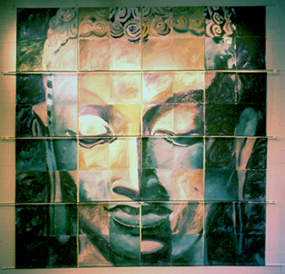

Psychological Flexibility
“It is defined as the ability to fully contact the present moment and the thoughts and feelings it contains without needless defense, and, depending upon what the situation affords, persisting or changing in behavior in the pursuit of goals and values.” (Hayes, et. al., 2006)

Slide 13
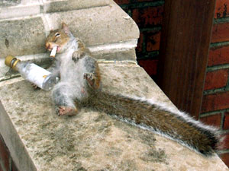
Why do we need Compassion?
Life is Hard

Slide 14
Compassion begins with a reality check
We come out of the world,
not into it. - Watts

Slide 15
Compassion begins with a reality check
We are an emergent species in the ‘flow of life’ so our brains, with their motives, emotions, and response patterns are products of evolution, designed to function in certain ways

Slide 16
Compassion begins with a reality check
We are designed for wanting, craving needing and seeking permanence – to fear and aggress, to love and to grieve – to know of our destiny.
Stardust, Grains of Sand, and Vast Neural Networks.

Slide 17
Compassion begins with a reality check
We move towards what might sustain and benefit us (appetitive stimuli) and away from that which may harm us (aversive stimuli).

Slide 18

Compassion begins with a reality check
Our lives are short (25,000-30,000 days), decay and end. We are subject to various malfunctions and diseases – in a genetic lottery. Everything changes – the nature of impermanence – the nature of tragedy
Notes:
18

Slide 19
Compassion begins with a reality check
The social circumstances of our lives, over which we have no control, have major implications for the kinds of minds we have, the kind of person we become, the values we endorse, and the lives we live
Notes:
19

Slide 20
Compassion begins with a reality check
So much in life that causes our suffering was not of our choosing and was not our fault.

Slide 21
So, Basic Philosophy is That:
We all just find ourselves here with a brain, emotions and sense of (socially made) self we did not choose but have to figure out
Life involves dealing with tragedies (threats, losses, diseases, decay, death) and people do the best they can
Much of what goes on in our minds is not of ‘our design’ and not our fault
We are all in the same boat
De-pathologising and de-labelling – understanding unique coping processes

Slide 22
Causes of Suffering
The Evolutionary Context
  Evolved Response Systems
  Evolutionary functionary analysis
Learning History
  Genotype and phenotype
  Social history
  Functional Analysis
The Present Moment Context
  Mindfulness/Sleepfulness
  Compassion/Threatened Mind
  Flexibility/Inflexibility

Slide 23
New Psychologies Emerge in the World
1 million? Extended caring
Human Symbolic thought and
(2 million?) self-identity, theory of mind, meta-cognition
Mammalian Caring, group, alliance-
(120 million?) building, play, status
Reptilian Territory, fear, aggression,
(500 million?) sex, hunting

Slide 24
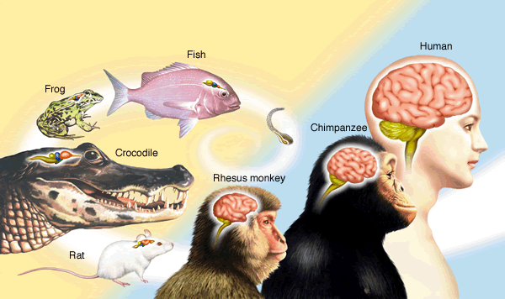
The human brain is the product of many millions of years of evolution – a process of conserving, modifying and adapting

Slide 25
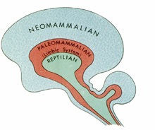
Brain Development in Deep Historical Context

Slide 26
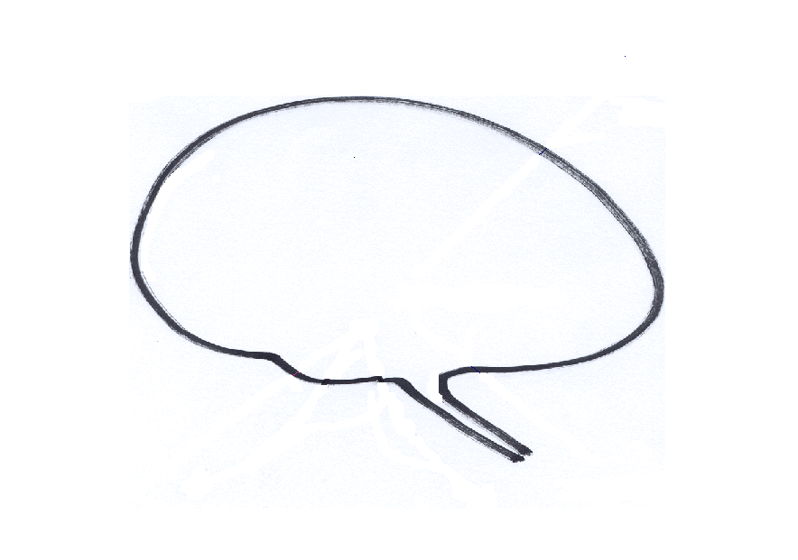

Sources of behaviour
Need compassion for a very tricky brain
New Brain: Imagination,
Planning, Rumination, Integration
Old Brain: Emotions, Motives, Relationship Seeking-Creating

Slide 27
Sources of behaviour
Need compassion for a very tricky brain
Mindful Brain
New Brain: Imagination,
Planning, Rumination, Integration
Old Brain: Emotions, Motives, Relationship Seeking-Creating
COMPASSION

Slide 28
Sources of behaviour
Need compassion for a very tricky brain
Mindful Brain
New Brain: Imagination,
Planning, Rumination, Integration
Old Brain: Emotions, Motives, Relationship Seeking-Creating
Threatened

Slide 29

Attention and Behavior

Slide 30
Built in Biases
Compassion insights
Biased learning – e.g., fear of snakes not electricity
Biases can be implicit (non-conscious) or explicit (Conscious)
Self-focused
Kin preferences – (nepotism)
In-group preferences – (tribalism)

Slide 31
“Thinky Pain”
Derived Relational Responding
Fusion
Avoidance, Control and Suppression

Slide 32
Mindfulness is a Context for
Compassion

Slide 33

Mindfulness as beginning
Within pre-scientific Buddhist traditions, mindfulness training is often a beginning point for the novice monk or lay practitioner.

Slide 34
Mindfulness as a Context
According to B. Allan Wallace (2009), historically, Buddhist practice did not suggest mindfulness was to be pursued as an end in itself.
Rather it was to be cultivated as an enduring state of being that allowed the further development of ‘wholesome states of mind.’ These states of mind would eventually lead to liberation from suffering.
Compassion was prominent among these states.

Slide 35

Mindfulness as foundation

Slide 36
Arising Compassion
This arising motivational imperative, known as bodhicitta (awakened heart) (Chödrön, 2003), is a major foundation of Buddhist practice.

Slide 37
Understanding our Motives and Emotions
Motives and their social mentalities evolved because they help animals to survive and leave genes behind
Emotions guide us to our (social) goals, respond if we are succeeding or threatened
There are three types of emotion regulation
Those that focus on threat and self-protection
Those that focus on doing and achieving
Those that focus on contentment and feeling safe

Slide 38
Types of Affect Regulator Systems
Drive, excite, vitality
Content, safe, connected
Non-wanting/
Affiliative focused
Safeness-kindness
Soothing
Incentive/resource- focused
Wanting, pursuing, achieving, consuming
Activating
Threat-focused
Protection and
Safety-seeking
Activating/inhibiting
Anger, anxiety, disgust

Slide 39
Types of Affect Regulator Systems
Threat-focused
Protection and
Safety-seeking
Activating/inhibiting
Anger, anxiety, disgust
Notes:
39

Slide 40
Threat-focused
Protection and
Safety-seeking
Activating/inhibiting
Anxiety
Body/feelings
Tense
Heart increase
Dry mouth
“Butterflies”
Afraid
Attention/Thinking
Narrow-focused
Danger threat
Scan – search
Internal vs. external
(attribution prediction)
Behaviour
Passive avoidance
Active avoidance
Submissive display
Dissociate

Slide 41
Threat-focused
Protection and
Safety-seeking
Activating/inhibiting
Anger
Body/feelings
Tense
Heart increase
Pressure to act
Anger
Attention/Thinking
Narrow-focused
Transgression/block
Scan – search
Internal vs. external
(attribution prediction)
Behaviour
Increase outputs
Aggressive display
Approach
Dissociate

Slide 42
Threat relations
Conflicts of Emotions
blocks
Anger
Anxiety
blocks
blocks
Sadness
Each emotion can have its own body states, cognitions, action tendencies and memories

Slide 43
Understand conflicts between Motives, Emotions and Strategies
What gets Blocked?

Slide 44
Types of Affect Regulator Systems
Drive, excite, vitality
Incentive/resource- focused
Wanting, pursuing, achieving, consuming
Activating
Threat-focused
Protection and
Safety-seeking
Activating/inhibiting
Anger, anxiety, disgust
Notes:
44

Slide 45
Lottery
£ $ £ $ £ $

Slide 46
Incentive/
resource-focused
Wanting, pursuing, achieving, consuming
Activating
Pleasure
Body/feelings
Activation
Heart increase
Pressure to act
Disrupt sleep
Attention/Thinking
Narrow-focused
Acquiring
Explorative
Internal vs. external
(attribution prediction)
Behaviour
Approach
Engage
Socialise
Restless
Celebrating

Slide 47


Slide 48
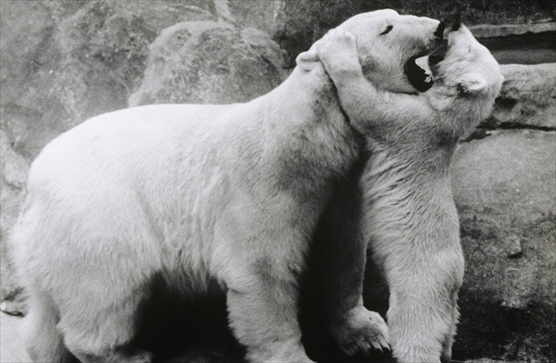

Slide 49
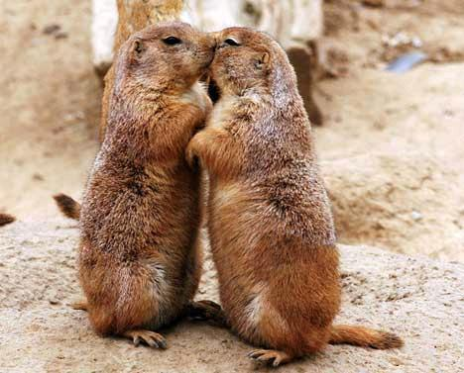
Notes:
49

Slide 50
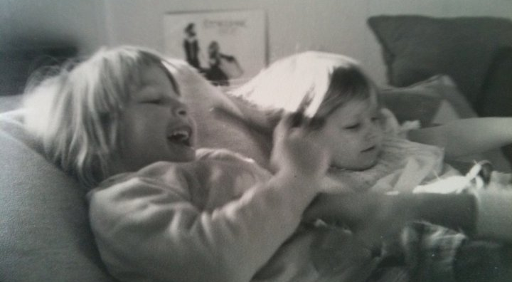

Slide 51
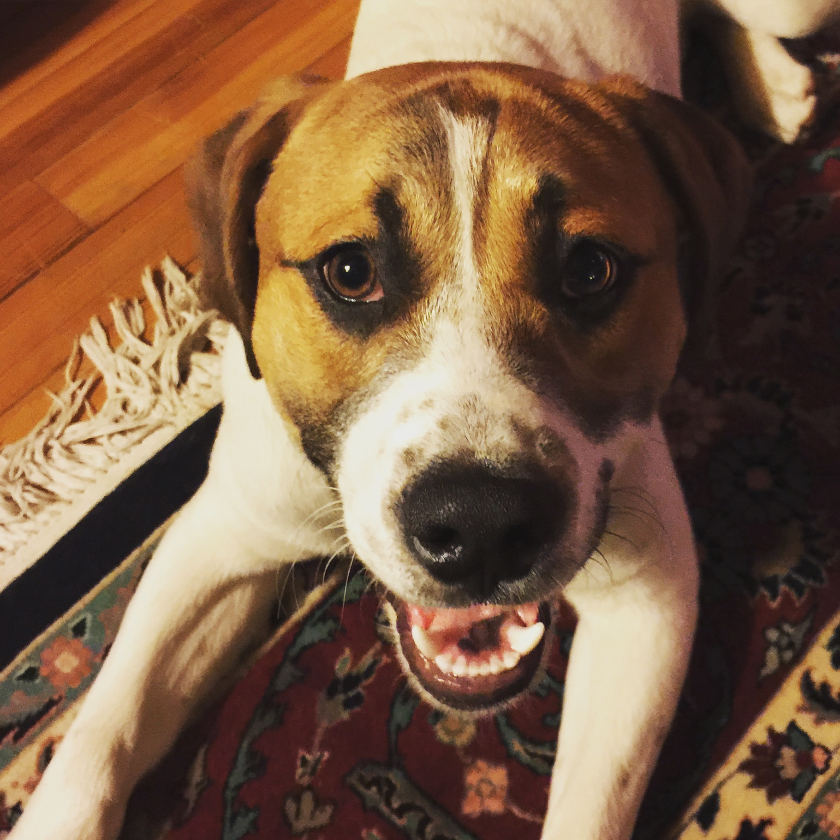

Slide 52
Types of Affect Regulator Systems
Drive, excite, vitality
Content, safe, connected
Non-wanting/
Affiliative focused
Safeness-kindness
Soothing
Incentive/resource- focused
Wanting, pursuing, achieving, consuming
Activating
Threat-focused
Protection and
Safety-seeking
Activating/inhibiting
Anger, anxiety, disgust

Slide 53
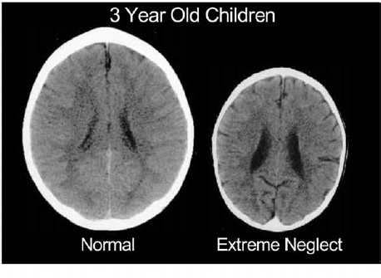
Perry, B. (2002). Childhood Experience and the Expression of Genetic Potential: What Childhood Neglect Tells Us About Nature and Nurture. Brain and Mind, 3:79–100.

Slide 54
Safeness
and Soothing

Slide 55
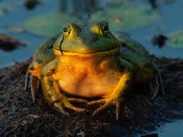
Contentment

Slide 56
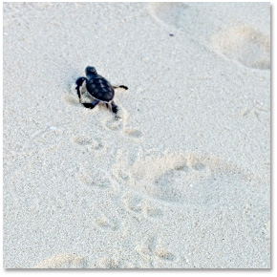
Self-Protection
In species without attachment only 1-2% make it to adulthood to reproduce. Threats come from ecologies, food shortage, predation, injury, disease. At birth individuals must be able to ‘go it alone’, be mobile and disperse

Slide 57
Dispersal and avoid others

Slide 58
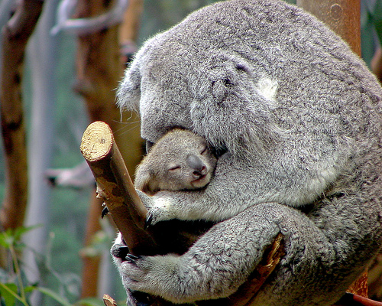

Slide 59
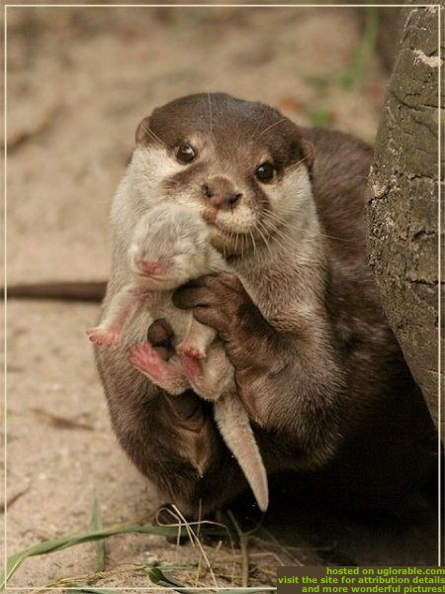

Slide 60


Slide 61


Slide 62

The Mammalian Importance of Caring Minds
Caring as ‘looking after’. Seeking closeness rather than dispersion. Individuals obtain protection, food, and care when ill. Key also is soothing-calming and physiological regulation. Few offspring but high survival rate in comparison to species without attachment, affection and kindness
Co-operative and mutual support can develop as we see that our prosperity impacts on that of others, sharing and not-exploiting
Notes:
62

Slide 63
Non-wanting/
Affiliative focused
Safeness-kindness
Soothing
Well-being
Body/feelings
Calm
Slow
Well-being
Content
Attention/Thinking
Open-focused
Reflective
Prosocial
Internal v. external
(attribution prediction)
Behaviour
Peaceful
Gentle
Pro-social
Notes:
63

Slide 64
Between self and others
Self to self
Self-to self
Calms
Affiliative/ Soothing
Threat
120 Million year evolving system to regulate threat
Notes:
64

Slide 65
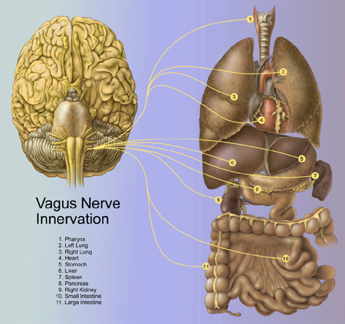
Safeness -connecting and the parasympathetic system: The Vagus Nerve
PNS influence on heart rate – slows beat down during outbreath
Associated with affiliation, tend & befriend, general positive emotional tone
Sensitive to safeness
Notes:
Emanating from the brainstem, the 10th cranial nerve, is the Vagus. The Vagus is affectionately referred to as the ‘wandering’ nerve – because it projects to so many parts of the body and is involved in a range of functions, as depicted by the yellow lines here. The Vagus nerve functions I would like to focus on – which have to do with mindfulness at the 2 and 3 levels, are it’s influence on heart rate, and it’s role in affiliative states. The yellow line that terminates on a number 4 – represents a shockingly important process – the Vagus nerve imparting parasympathetic influence on heart rate – that is – slowing the heart down. Without vagal input, your heart would beat unsustainably fast to your mortal demise. There is a rich scientific literature on this process, measuring the ratio of heart rate during inhale (driven by sympathetic input) and that during exhale (vagal input) – yielding a measure called Vagal Tone. Vagal Tone, it turns out, is predictive of a host of benefits: calm behavioral states, being better at relating to emotional experiences in a healthy way (a property often called resilience), generally experiencing more positive than negative emotional states, lower blood pressure, and more. Mindfulness practice has been shown to strengthen vagal tone (Ditto, McGill, Annals of Behavioral Medicine). That said, thinking about mindfulness & compassion, the capacity of vagal tone to adapt to environmental changes (e.g., physiological, cognitive or psychological challenges) defined as vagal flexibility, e.g. high vagal flexibility allows sympathetic activity to occur and limits efficiently the stress period to the stressors presence may be the measure of importance. Studies have shown that vagal recovery may be more strongly associated with mindfulness than vagal tone alone.
The second function I’d like to touch upon comes from a pioneering scientist named Steve Porges, author of the PolyVagal theory – which suggest that a primary funciton of the Vagus nerve is to support affiliation and the formation of social ties that lead to long term relationships. Coming from a functional biological perspective, Porges suggests that the Vagus nerve’s visceral input to the brain, support of vocal fluctuations and parasympathetic influence drives people to approach others for cooperative gain, to communicate in close proximity, and develop dependencies. An entire field has emerged from Porges’s – including work by Dacher, Stepahie Brown, and others. A key part of the story here is that vagal influence is exxentially silenced by fear, vigilance to threat, anxiety, etc…
An emerging science on the study of MindWandering – that is – absentmindedly thinking about what’s not happening right now – is deleterious to happiness – engages systems that typically track thoughts about the self: what happened, what might happen, and why they might not like me…a style of reflexive thinking for which mindfulness is pointedly an antidote.
65

Slide 66
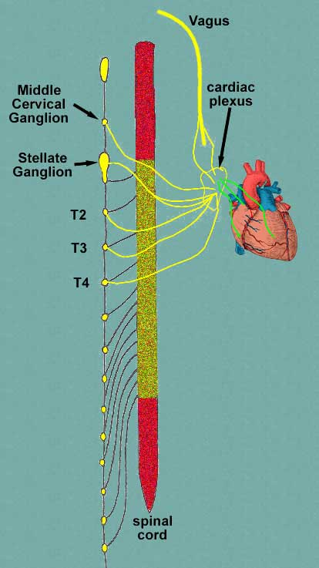
Parasympathetic nerves to heart
Slows HR
Sympathetic nerves to heart
Increases HR
Notes:
66
66

Slide 67
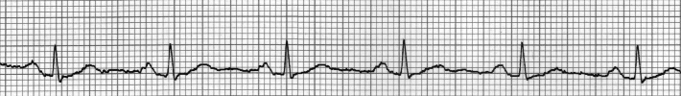
Successive Inter-beat Intervals
(ms)
945
897
858
799
821
846
851
858
879
879
Standard Deviation of Inter-beat Intervals over 300 second period = SDNN
Notes:
67
67

Slide 68
Source: www.coherence.com

Slide 69
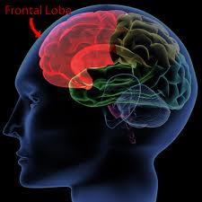
‘New Brain’ with Frontal cortex and PNS
HRV ass. with flexibility
Mindful attention
Control of attention
Reflective thinking
Empathy – mentalizing
Not acting on emotions

Slide 70
‘Some Overloads for New brain
Chronic sympathetic arousal
Rapid shifts of attention
No time for reflective thinking
Fear based (personal distress) based arousal
Self-criticism and self-doubt
Systemic failures in support

Slide 71
Attachment
Proximity seeking –desire closeness, to be with
Safe base –source of security to go out and explore and develop confidence
Safe haven –source of conflict comment and emotion regulation
Social signals are the drivers (social mentality)

Slide 72


Slide 73


Slide 74


Slide 76
Internal Threat and Soothing
Self-affiliation – experiences a lovable self
Calms
Affiliative/ Soothing
Threat
Internal representations of helpful others and sources of comfort
Neurophysiological networks
Emotional memories of soothing

Slide 77
Functional Safeness
Supports relationship building and pro-social behaviour
Calms
Affiliative/ Soothing
Threat
Can regulate threat via access to others and later internal soothing
Develop mentalizing and empathy skills
Safe to explore and have open attention – development of (social) intelligence

Slide 78
Internal Threat and More threat
No self-affiliation – experiences a unlovable self
Calms
Affiliative/ Soothing
Threat
Others are threats or alarming
Neurophysiological networks
Emotional memories of no soothing

Slide 79
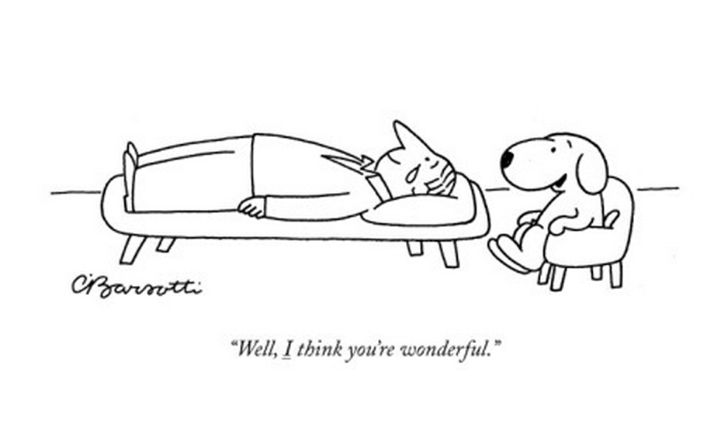
The Work of CFT in the relationship

Slide 80
Compassion Process
Giving/doing
Mindful Acts of kindness
Engagement with the feared
Receiving/soothing
Vagal Engagement
Validation
Gratitude appreciation
Compassionate Self
Threat
Mindful awareness
Triggers
In the body
Rumination
Labelling

Slide 81
Caring-Compassionate Mind
Warmth
Warmth
ATTRIBUTES
Sensitivity
Sympathy
Compassion
Distress tolerance
Care for well-being
Non-Judgement
Empathy
Warmth
Warmth

Slide 82
Compassionate Mind - Alleviation
SKILLS -TRAINING
Warmth
Warmth
Imagery
Attention
ATTRIBUTES
Reasoning
Sensitivity
Sympathy
Compassion
Distress tolerance
Care for well-being
Feeling
Empathy
Behaviour
Non-Judgement
Sensory
Warmth
Warmth

Slide 83
Compassionate Mind
Thinking
Reasoning
Attention
Imagery Fantasy
Compassion
Behaviour
Motivation
Emotions

Slide 84
Threatened Mind
Thinking
Reasoning
Attention
Imagery Fantasy
Threatened
Behaviour
Motivation
Emotions

Slide 85
Psychological Flexibility
“It is defined as the ability to fully contact the present moment and the thoughts and feelings it contains without needless defense, and, depending upon what the situation affords, persisting or changing in behavior in the pursuit of goals and values.” (Hayes, et. al., 2006)

Slide 86
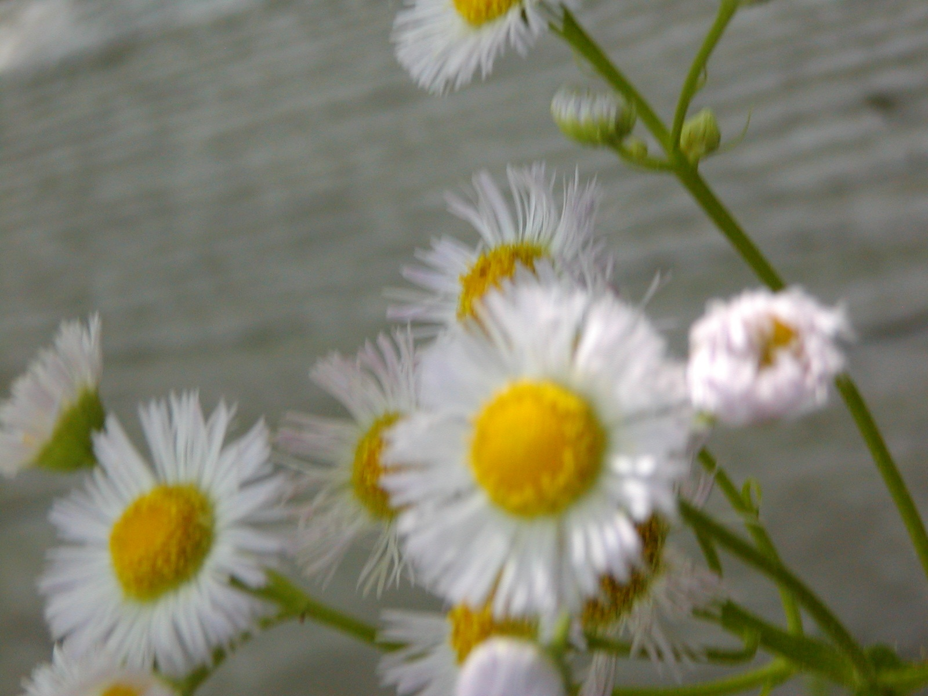
Psychological Flexibility
“In this very moment, will you accept the sad and the sweet, hold lightly stories about what’s possible, and be the author of a life that has meaning and purpose for you, turning in kindness back to that life when you find yourself moving away from it?”
(Wilson & Dufrene, 2010)

Slide 87


Examples of Psychological Flexibility’s Importance
In more than 40 studies with nearly 10,000 participants, psychological flexibility accounts for 16 to 33% of most psychological outcomes
There is evidence that the effects of negative thoughts, difficult feelings, maladaptive coping, emotional response styles, cognitive reappraisal, and perceived controllability, are all partially or fully mediated by psychological flexibility (Hayes, 2008)

Slide 88
Psychological Flexibility
Present Moment Contact
Values Authorship
Willingness
Psychological Flexibility
Defusion
Commitment
Self-As-Context

Slide 89
Compassionate Flexibility
Sensitivity
Distress Tolerance
Care For Well-Being
CompassionateFlexibility
Non-Judgment
Commitment to Compassionate Behavior
Sympathy,
Empathy
Notes:
Eisenberg model of altruism research, sympathy, empathy, and personal distress (in Harrington and Davidson, 2002) + Compassionate Motivation and Attention (Buddhism) + Nonjudgement – Gilbert, 2009 (also Allen Fogel’s model of nurturant behavior

Slide 90
Formation of Self-as-Context:
The No-Thing Self (Hayes, 2008)
YOU
HERE
NOW
I
THERE
THEN

Slide 91
I-Here-Nowness of Perspective Taking
Self-as-context

Slide 92
Compassionate Flexibility
Compassionate flexibility reflects a particular quality of engaged psychological flexibility
defined as . . .
The act of contacting the present moment fully, as a conscious and emotionally responsive human being with the following qualities:
Notes:
Eisenberg model of altruism research, sympathy, empathy, and personal distress (in Harrington and Davidson, 2002) + Compassionate Motivation and Attention (Buddhism) + Nonjudgement – Gilbert, 2009 (also Allen Fogel’s model of nurturant behavior

Slide 93
Compassionate Flexibility
Sensitivity to the presence of suffering in oneself and others
Motivation to alleviate and prevent human suffering in oneself and others
Persistent adaptation to competing and changing environmental, emotional, and motivational demands and commitment to returning attention and resources to the alleviation and prevention of suffering in oneself and others
Notes:
Eisenberg model of altruism research, sympathy, empathy, and personal distress (in Harrington and Davidson, 2002) + Compassionate Motivation and Attention (Buddhism) + Nonjudgement – Gilbert, 2009 (also Allen Fogel’s model of nurturant behavior

Slide 94
Compassionate Flexibility
The ability to flexibly shift perspective and access a broader sense of oneself and others, involving the experience of empathy and sympathy
The ability to disentangle oneself from the excessive influence of evaluative, judgmental thoughts
Maintaining an open and non-condemning perspective on human experience itself, thereby cultivating necessary and sufficient willingness to tolerate the distress encountered in oneself and others
Notes:
Eisenberg model of altruism research, sympathy, empathy, and personal distress (in Harrington and Davidson, 2002) + Compassionate Motivation and Attention (Buddhism) + Nonjudgement – Gilbert, 2009 (also Allen Fogel’s model of nurturant behavior

Slide 95
Compassion as Flow
Different practices for each
Other Self
Self Other
Self Self
Non linear empathy for other begins early in life

Slide 96
Self Compassion
Neff (2003b) has operationalized self-compassion as consisting of three main elements:
Self-kindness vs harsh criticism and self-judgment
A sense of common humanity vs seeing self as separate and isolated
Mindfulness vs overidentification

Slide 97
Mindfulness
Self-Kindness
Present
Moment
Acceptance
Values
Psychological Flexibility
Defusion
Commitment
Self
As Context
Common Humanity

Slide 98
Self-Criticism vs Self-Compassion
Shame Self-Attacking Desire to punish and condemn Backward looking Linked to disappointment and focusing on deficits Emotions are anger frustration anxiety contempt Consider critical teacher with a child who is struggling
Compassionate Self-Correction Desire to improve - at one’s best Forward looking Linked to building on the positives and abilities Validation of set back and encouragement Consider compassionate teacher with a child who is struggling
Notes:
98
98

Slide 99
Compassion as Flow
Different practices for each
Other Self
Self Other
Self Self
Non linear empathy for other begins early in life

Slide 100
Compassionate chair work
Key focus is building up the feelings, tolerance, insights and strengths of the compassionate part of the self
Spend time and normalise: strengthen those parts capable of growth, change and healing (e.g. compassionate self)
1) Discuss nature of the different parts of self
Generate a collaborate agreement
2) Choose which chairs and which roles client can be active in
3) “Consider becoming the part you want to work on”
### e.g. anger, anxiety, shame, self-criticism, sadness
Noticing feeling and bodily experiences of that part. Start with mild examples and work up according to client abilities
5) Client switches to a facing chair, maybe working around first to disengage from the part they are working with
4) “Recall a time when you felt that ### part”
### in voice of past abuser is marked as 'not self'
6) Use soothing breathing rhythm in the compassion chair with mindfulness. Provide guidance: “In your compassion chair now, engage your soothing breathing rhythm and feel your body slowing down. Now focus on becoming 'you at your best'... Maybe remember a time when you felt calmer, wiser and kind... Imagine all the qualities you would ideally like to have as a compassionate person... Notice how thinking about them can help you feel in touch with them... Allow yourself to have a compassionate expression... Calmly and gently visualise yourself having wisdom, maturity, authority and strength as you sit there... With your soothing rhythm, as your body is slowing down, feel yourself becoming the compassionate self.” When contact with a compassionate self is made invite them to spend time just feeling compassion for the ### part (Check that the self-critical part is not an abuser' voice, as this is a different process).
7) If the person feels pulled by the other ### chair, then just break contact with the chair and refocus on “becoming the compassionate self”
Brief summary aide-memoire of Chapter 22 of Paul Gilbert (2010) Compassion Focused Therapy. Hove: Routledge

Slide 101
Supporting Research
Practice of imagining compassion for others produces changes in frontal cortex and immune system (Lutz et al, 2008)
Loving kindness meditation (compassion directed to self, then others, then strangers) increases positive emotions, mindfulness, feelings of purpose in life and social support and decreases illness symptoms (Frederickson et al, 2008, JPSP)
Compassion meditation (6 weeks) improves immune function, and neuroendocrine and behavioural responses to stress (Pace, 2008, PNE)
Viewing sad faces, neutrally or with a compassionate attitude influences neurophysiological responses to faces (Ji-Woong Kim, 2009, NP)
Compassion training reduces shame and self-criticism in chronic depressed patients (Gilbert & Proctor, 2006, CPP)

Slide 102
Supporting Research
Hutcherson, Seppala and Gross (2008) found that a brief loving-kindness meditation increased feelings of social connectedness and affiliation towards strangers.
Compassionate letter writing to oneself has been found to improve coping with life events and reduces depression (Leary, Tate, Adams, et al., 2007).
Schanche and colleagues (2011) found that self-compassion was an important mediator of reduction in negative emotions associated with cluster is C personality disorders and recommended self-compassion as a target for therapeutic intervention.
Kuyken and colleagues (2010) found that self-compassion was a significant mediator between mindfulness and recovery in a study of the effectiveness of Mindfulness Based Cognitive Therapy for depression.

Slide 103
Supporting Research
A review of research concerning both clinical and nonclinical settings, compassion-focused interventions have been found to be significantly effective (Hofmann, Grossman, & Hinton, 2011).
Self-compassion has been found to offer protection against anxiety and depression, even when controlling for self-criticism. People who report high levels of self-compassion on the SCS also report high levels of many positive psychological traits such as autonomy, competence, and emotional intelligence (Neff, 2003; Neff, Rude, & Kirkpatrick, 2007).
Ashworth, Gracey & Gilbert, (2011) found CFT to be a helpful addition and focus for people with acquired brian injury in an uncontrolled trial.

Slide 104
Supporting Research
Braehler and colleagues (2012) found significant clinical improvement and increases in compassion, as well as high levels of tolerability and low attrition, as compared to a treatment as usual condition.
In a clinical trial, Laithwaite and colleagues (2010) found significant effects for depression, self-esteem and an improvement in sense of self compared to others, in a sample of patients in recovery from psychosis in a forensic mental health setting.
CFT has been found to be significantly effective for the treatment of personality disorders (Lucre & Corten, 2012), eating disorders (Gale et. al., 2012) and heterogeneous mental health problems in people presenting to community mental health teams (Judge & et.al., 2012).
Van Dam and colleagues (2010) found that self-compassion accounted for as much as 10 times more unique variance in psychological health than a measure of mindfulness did in a large community sample.

Slide 105
Future Directions
Testing Contextual Compassion Focused Therapy
The Development of Assessment Measures
Anger
Psychosis
Contextual Compassion Focused Therapeutic Community
Trauma
Emotion Regulation
TBI
Smoking Cessation
CCARE
Shame & Stigma
Compassionate Organizations
Scalable Education
CF-SIG
CMF Inernational

Slide 106
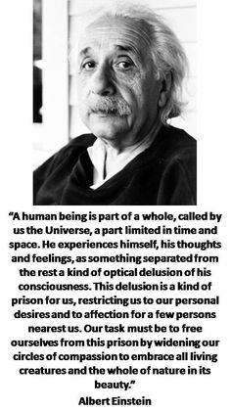

Slide 107
The ACT of Compassion

